Slide 1
Future of Maritime Development In Nigeria and The Need To Prepare Ahead
BY
PROF. M. O. ILORI
Chairman, Board of IMS

Slide 2
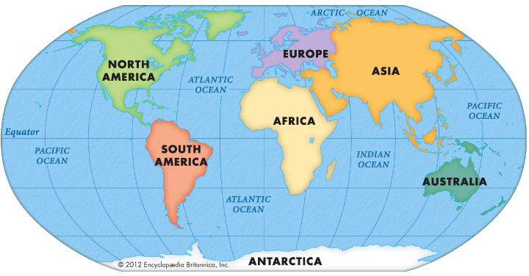
OCEANS CONSTITUTE ABOUT 71% OF THE EARTH'S SURFACE
http://1.bp.blogspot.com/-VUFD3yYrZBQ/ViuNq_vyK2I/AAAAAAAADek/AQTKdVfb1Y8/s1600/2015-10-24_0953.png

Slide 3
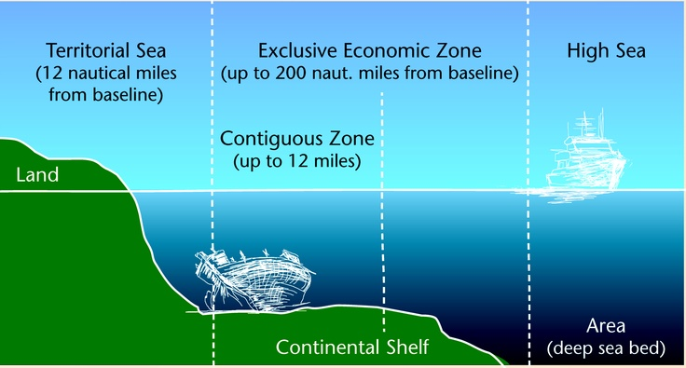
THE UNITED NATION’S CONVENTION ON LAWS OF THE SEA
http://cimsec.org/wp-content/uploads/2014/06/Maritime-Zones.jpg-2.jpg

Slide 4
WHY IS THE KNOWLEDGE AND CARE OF THE OCEAN IMPORTANT?
The ocean is one of Earth's most valuable natural resources.
It provides food in the form of fish and shellfish.
It is used for transportation—both travel and shipping.
It provides a treasured source of recreation for humans.
It is mined for minerals (salt, sand, gravel, and some
manganese, copper, nickel, iron, and cobalt can be found in
the deep sea)
It is provides crude oil.
The ocean plays a critical role in removing carbon from the
atmosphere and providing oxygen.
It regulates Earth's climate.
The ocean is an increasingly important source of biomedical organisms with enormous potential for fighting disease.

Slide 5
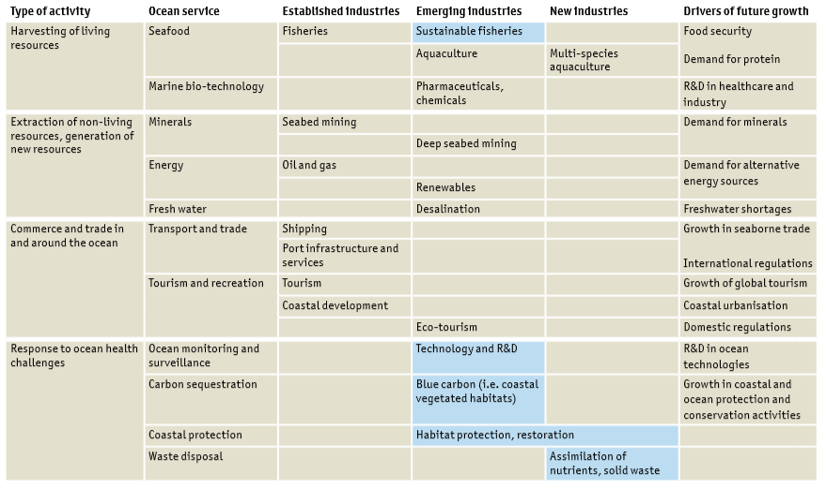
The blue economy

Slide 6
Overview of the Nigerian Maritime Industry
Nigeria's maritime trade accounts for approximately 60% of our national GDP and this translates to over 70% of our National income
Nigeria plays a key role in the West and Central African region and the entire Gulf of Guinea (GG).
domestic and international shipping traffic and maritime safety and security operations.
Gulf of Guinea is a maritime environment that extends from the West sea coast of the Atlantic Ocean from Cape Palmas in Liberia down to Namiibe in Angola.
Gulf of Guinea.

Slide 7
SOME PROBLEMS CONFRONTING THE MARITIME INDUSTRY IN NIGERIA
Inconsistent maritime policies affect long time investments – e.g. import duty and levy payable on new and fairly used vehicles were raised from 20% to 70%
Maritime industry operations are mainly dollarized and forex restrictions and lack of policy direction by the government is inimical to development
Frequent sack and fresh appointment of Heads of key governmental units
reverse gain of long time experience as frequent new comers have to learn
the rules all over.
Lack of maintenance of port infrastructure,
Low support or inadequate patronages of local businesses
No meaningful participation of the shipping industry for exports and
imports.
The Nigeria Inland Waterways Network is reputed to be one of the longest
in the world spanning over 3000 km. However, this great transport
resource is still underutilized.
Lack of support to indigenous shipping companies to improve their fleet
expansion. E.g. Proceeds of the Cabotage Vessel Financing Fund (CVFF)
could be used to assist.
Indigenous shipping business is currently in a state of collapse.

Slide 8
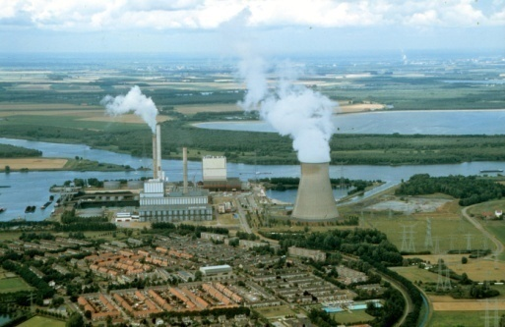
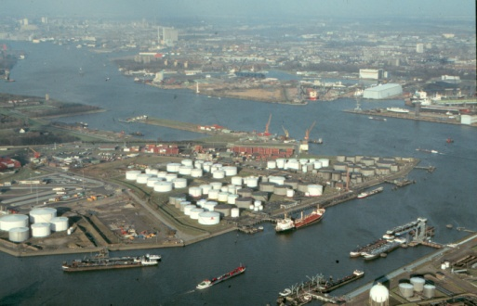
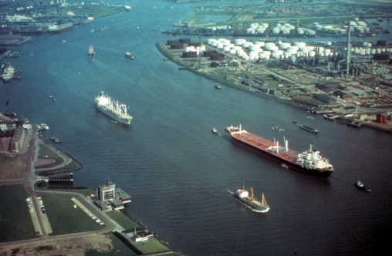
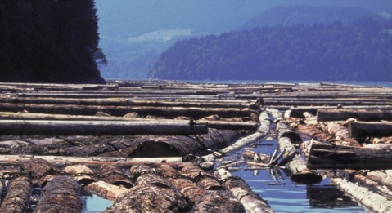
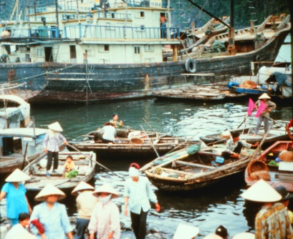
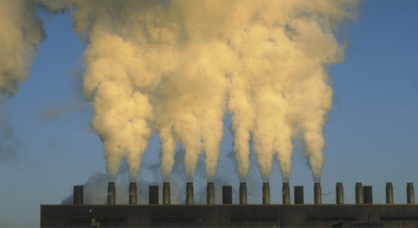
Insert Page Title here
HUMAN ACTIVITIES POLLUTE THE MARINE ENVIRONMENT
Insert Page Content Here
80% of all marine pollution comes from land-based activities!

Slide 9
Challenges of Maritime Development In Nigeria
Nigerian maritime development have been facing lingering problem:
Poor Delineation of Maritime Boundaries.
Difficult to Enforce and Total Sea Control (Safety and Security)
Poor Environmental Management Control Ability.

Slide 10
Maritime Development In Nigeria Challenges II
Poor Maritime Culture.
Weak/Limited Capacity for proper maritime governance.
Lack of Political Will to domesticate extant
Improper domestication and implementation of international laws, protocol and conventions
infrastructure shortcomings
policy and regulatory inconsistencies
Overlapping functions and duplication of roles among the Ministries, Departments and Agencies

Slide 11
Maritime Development In Nigeria Challenges III
We make money from the maritime industry without giving
back for its maintenance and development,
We have left the access road network to deteriorate to an
embarrassing due to movement of heavy goods,
Original rail bulk cargo carriage concept was left to rot and
undeveloped
Large ocean liners require constant dredging that is seldom
carried out,
Over reliance on foreign experts who come and take money out
,
Inability of government to develop local training capacity for
sea fearers,
No major or capital investment in the industry,
Non enforcement of the Cabotage law

Slide 12
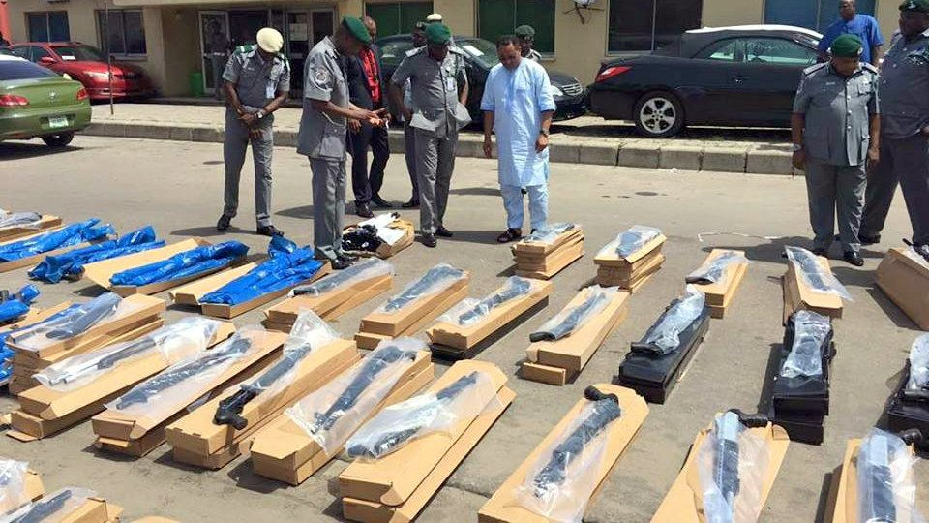
NEGLIGENCE/OVERLOOK/MISTAKE/FRAUD MAY BE COSTLY

Slide 13
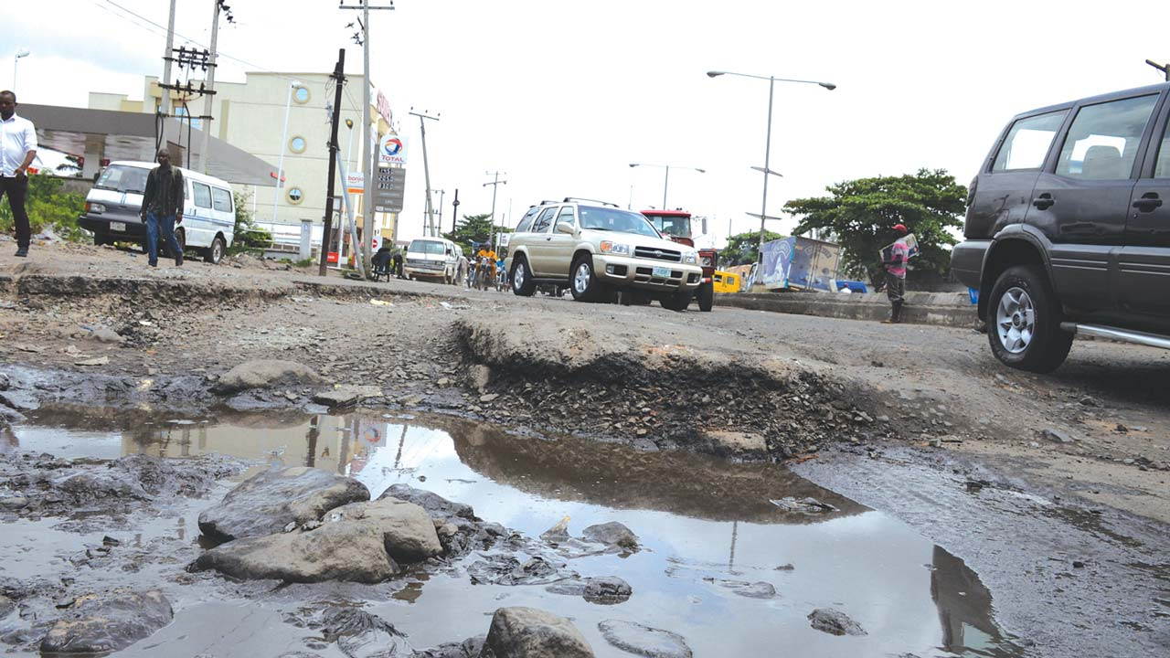
GOVERNMENT GIVE TARGETS BUT MUZZLE THE OX THAT TREADS THE GRAIN
https://guardian.ng/wp-content/uploads/2017/05/Apapa-28-05-17.jpg

Slide 14
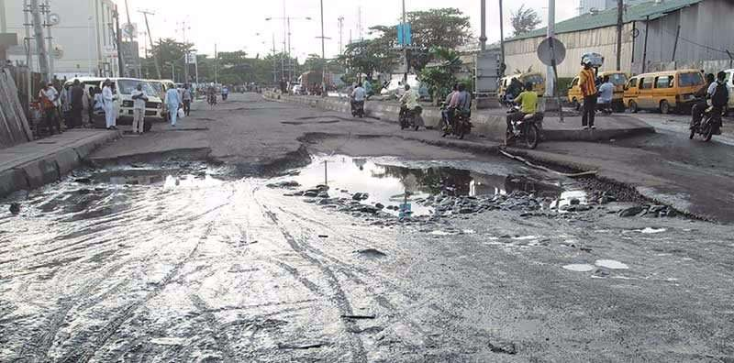
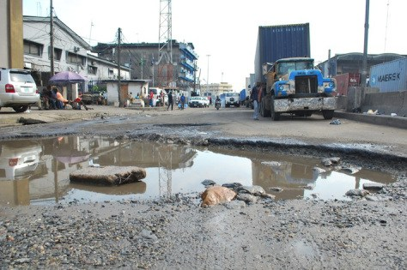
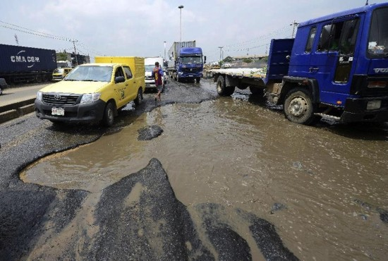
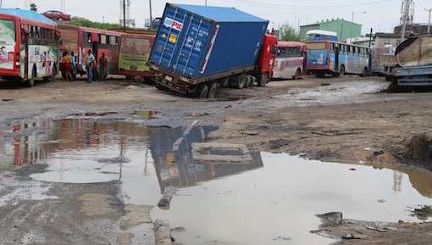

Slide 15
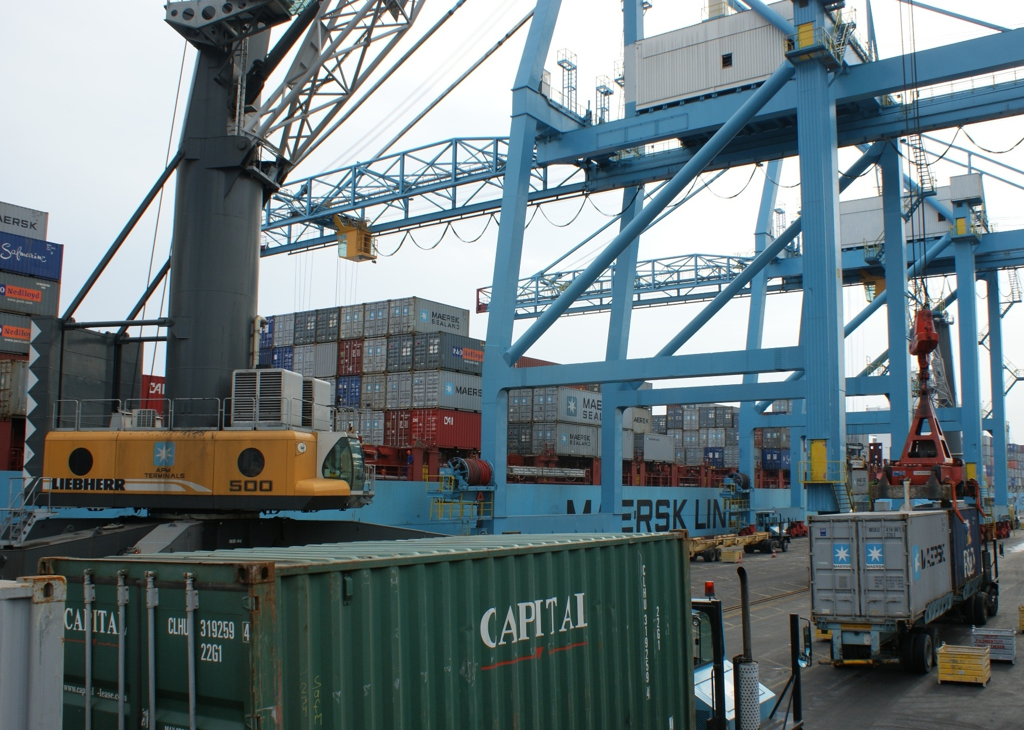
OUTDATED CRANES
http://www.portstrategy.com/__data/assets/image/0028/187714/Apapa-Lagos-Nigeria-APMT.jpg

Slide 16
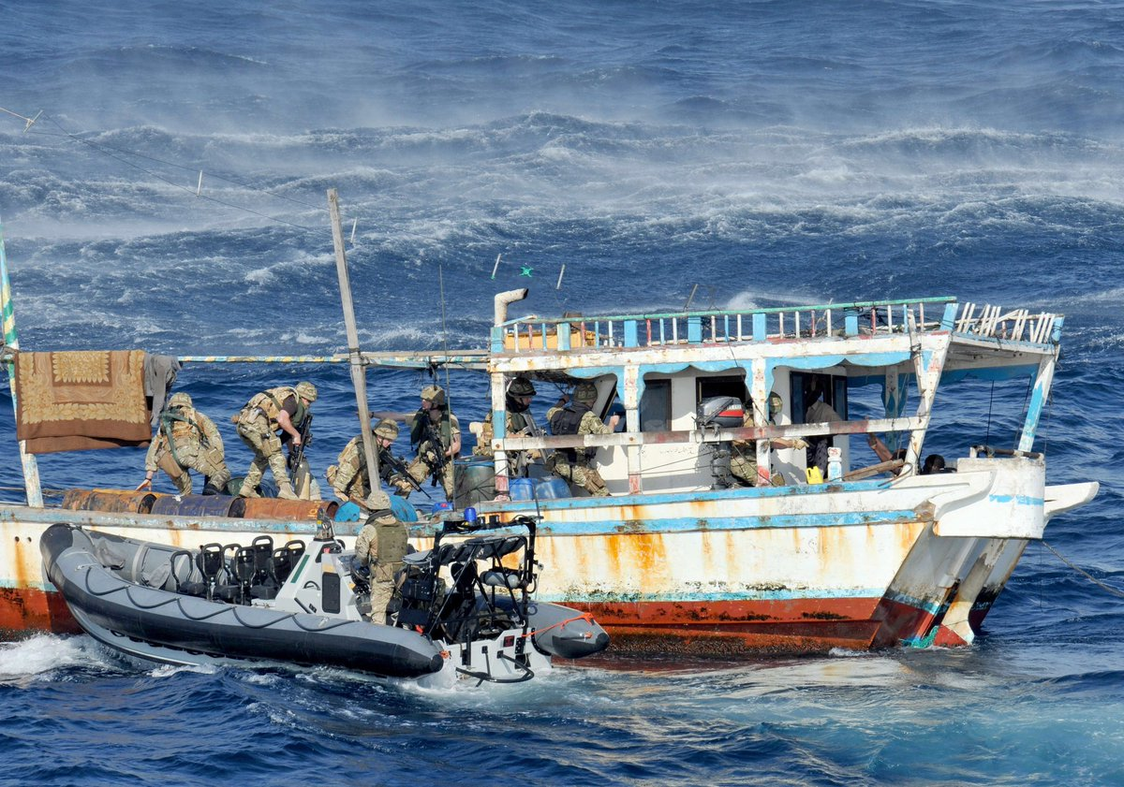
PIRACY
https://pbs.twimg.com/media/DAV05b1XYAA3pHJ.jpg

Slide 17
RECENT
POSITIVE
DEVELOPMENT

Slide 18
PORT CONCESSION INITIATIVE SEEMS TO BE WORKING
http://www.fivestarlogisticsltd.com/homepage%20header%205star%20website.jpg

Slide 19
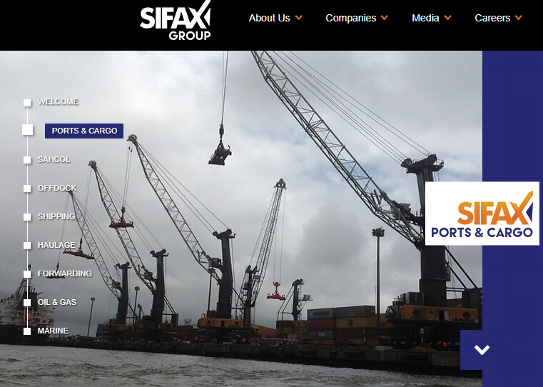
http://sifaxgroup.com/#2

Slide 21
SOME CURRENT ACTIONS
Concession to private entrepreneur,
Streamlining of processing of goods to allow
for easy clearance,
Training of cadets abroad by NIMASA,
Trickling investment in education – e.g.
establishment of new maritime schools
Plan to have a new National Shipping Carrier

Slide 22
SOME OF THE FUTURE EXPECTATIONS
Complete enforcement of cabotage,
More specialized universities and technical schools for
maritime industry,
Provision of a central training ship for cadets
Use of technology to fight fraud
Construction of major deep sea ports.

Slide 23
FUTURE EXPECTATIONS AT THE Ports
Improve port productivity with further reductions in turn around time for vessels;
Competition by the ports may lead to tariff reduction;
Development towards becoming the maritime hub of the region
Improve safety and security at the ports;
Dredge to accommodate large ocean liners
Improve RoRo facilities
Accommodate efficiently the growing container traffic
Move goods with rail directly from the ports
Use modern cranes and x-ray facilities for quick and fast clearing

Slide 24
FUTURE EXPECTATIONS ON SHIPPING
Facilitate indigenous participation in the carriage of crude
petroleum cargo;
Promote human capacity for the manning of maritime vessels by
Nigerians
Expand domestic shipping.
Increase in the navigable routes on the inland waterways;
Rehabilitation and construction of key river ports, jetties and
wharfs;
dredging and reclamation of the rivers Niger and Benue
Concession of selected routes to the private sector.

Slide 25
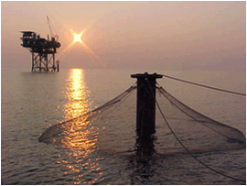
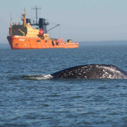
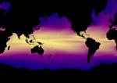
Adopting Smart Ocean / Smart Industries strategy
Appreciable Political will
Good ocean governance
Research and training
Capacity building
Marine/Coastal Area Spatial Development
Coastal literacy and protection

Slide 26
Emerging Challenges
Accommodating the multi-dimensional nature of the marine environment?
How to best cope with mobile and fixed uses?
Temporal influence?
Building capacity – who are our marine planners?
Institutional capacity? Balancing ecosystem and economic objectives
Transboundary aspects: cross-border and shared sea environments
Implementation and adaptive management
Do we have sufficient monitoring to allow for adaptive management?
Data?

Slide 27
IMS – UNILAG, IN THE BEGINNING
IMS was established in 2013 by the University of Lagos in conjunction with Nigerian Maritime Administration and Safety Agency (NIMASA)
The main aim is to address the chronic shortage of personnel in the Nigerian maritime industry, this shortage has always and often been filled by foreigners.
The maritime industry is key to the proper operation of the Nigerian economy.
NIMASA is partnering with the
- University of Lagos,
- University of Nigeria,
- Niger Delta University
- Ibrahim Babangida University
to float maritime programmes and certify interested new entrants into the industry

Slide 28
SUPPORTING DEPARTMENTS/FACULTY
University of Lagos has existing and complimentary departments including:
Marine Sciences,
Surveying & Geoinformatics,
Law,
Engineering,
Business Administration,
Actuarial Science & Insurance,
Computer Sciences,
Mathematics,
Microbiology,
Economics,
Geography.
The staff and facilities of the departments/faculty are readily available for the maritime programmes taught in IMS

Slide 29
AVAILABLE PROGRAMMES
By 2016/2017 Session, the following programmes are available at IMS:
Postgraduate Diploma in Maritime Communication and Navigation
Postgraduate Diploma in Maritime Environmental Studies
Postgraduate Diploma in Maritime Administration and Management

Slide 30
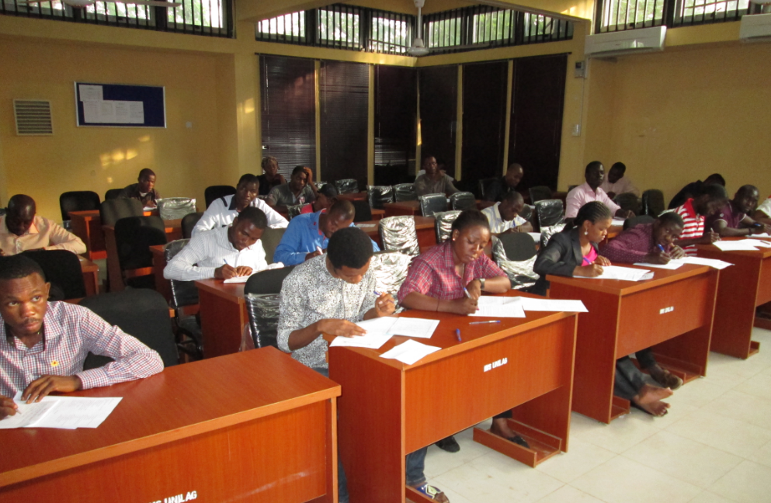
One of the dedicated classrooms of IMS

Slide 31
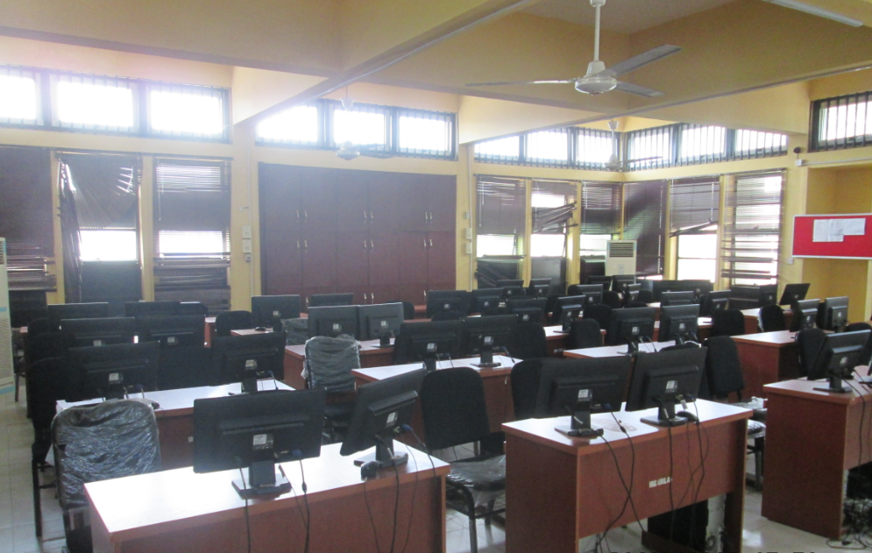
One of the dedicated computer labs of IMS

Slide 32
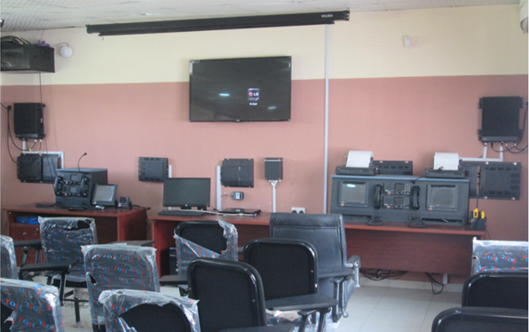
The dedicated GMDSS lab of IMS

Slide 33
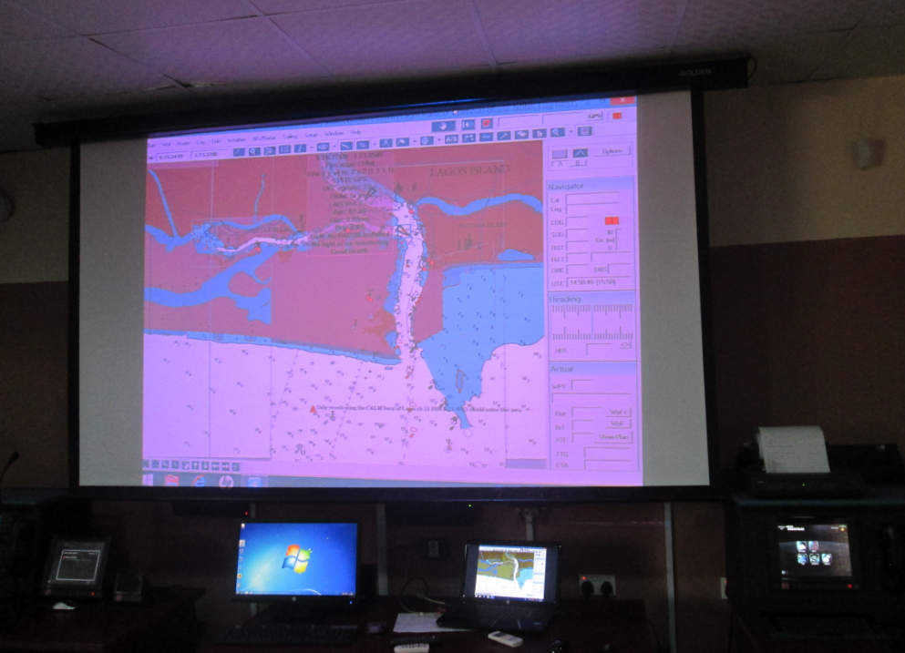
The Automatic Identification System (AIS) & GMDSS in Operation

Slide 34
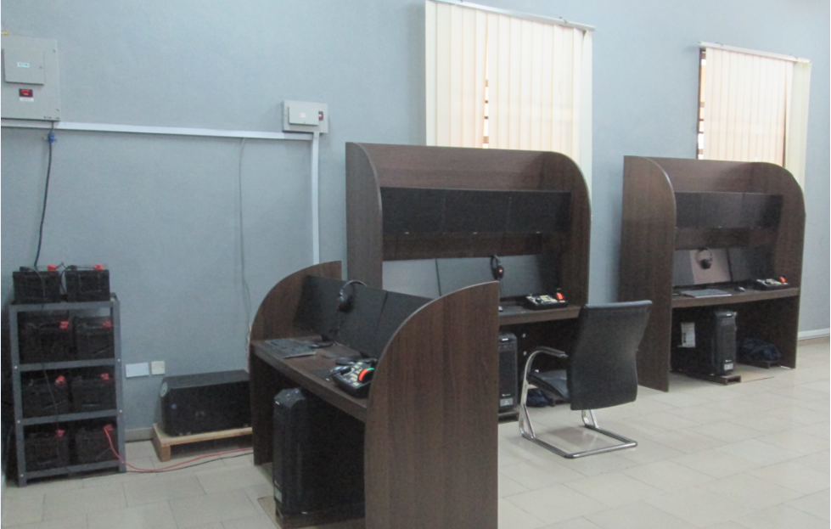
The Ship Bridge Simulation Lab

Slide 35
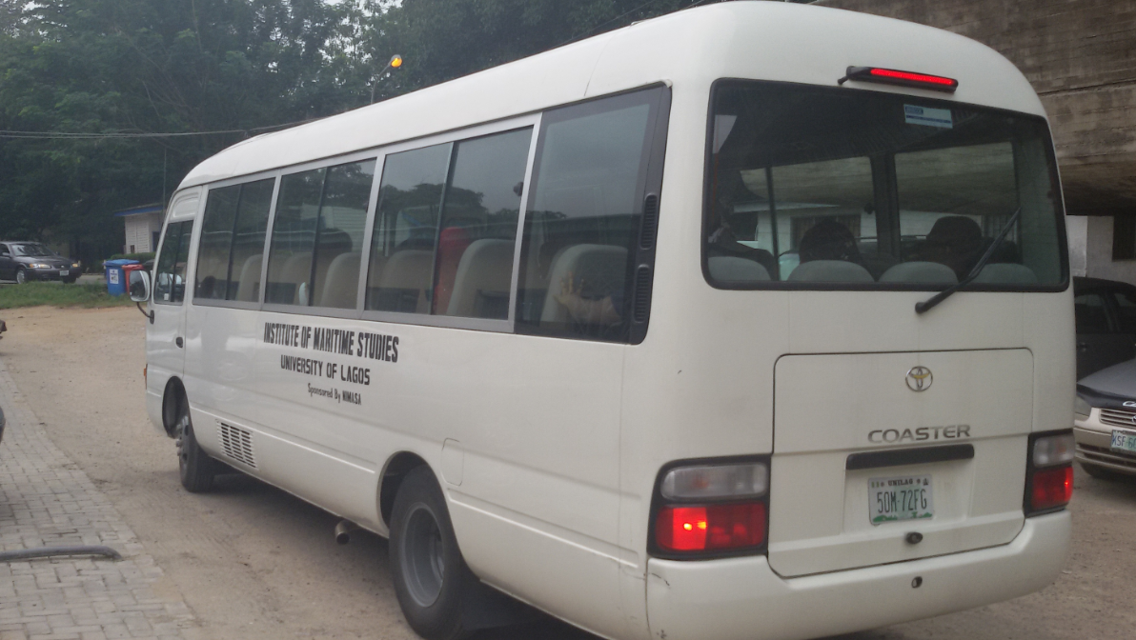
The Coaster Bus used by Students for Field Trips

Slide 36
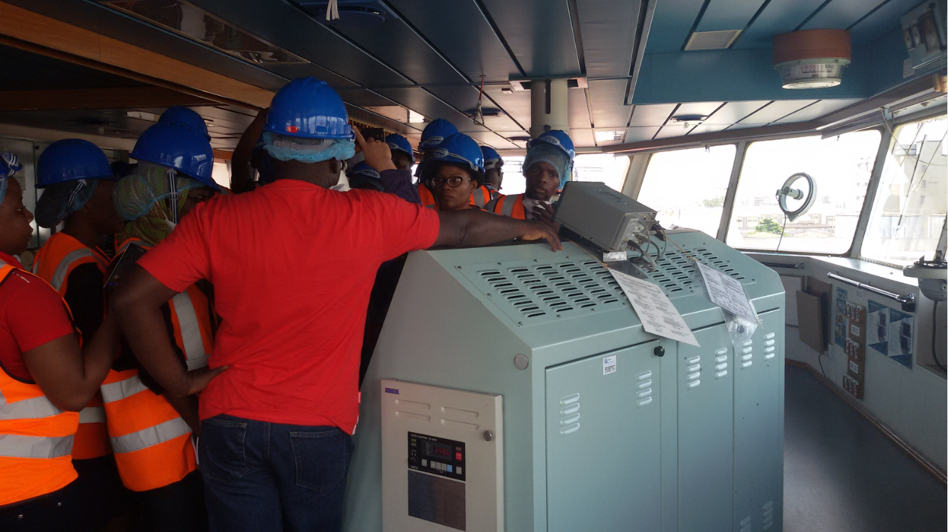
Students on industrial visit

Slide 37
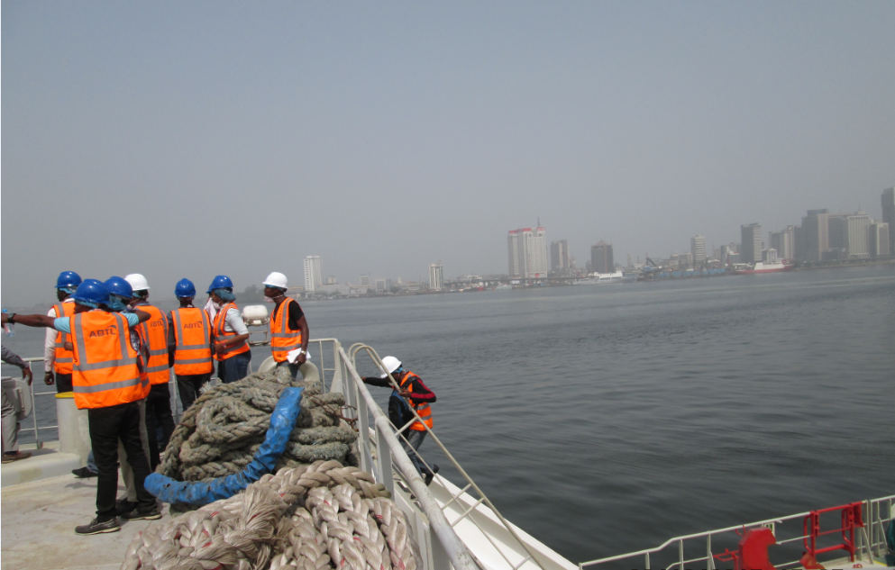
Students on industrial visit

Slide 38
NEW DEGREE PROGRAMMES IN CONSIDERATION
Professional Masters in Hydrographic Surveying
Professional Masters in Maritime Safety and Security
Professional Masters in Oil & Gas Shipping
B. Sc Marine Engineering
B. Sc. Nautical Science

Slide 39
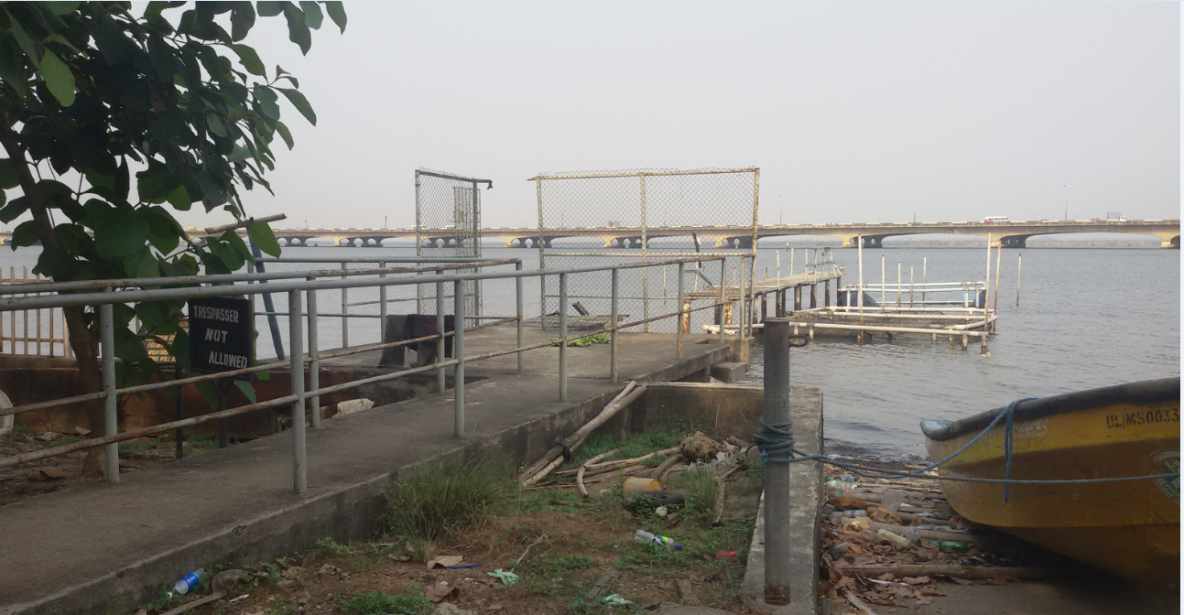
***PLEA FOR REPAIR AND EXPANSION OF BROKEN JETTY

Slide 40
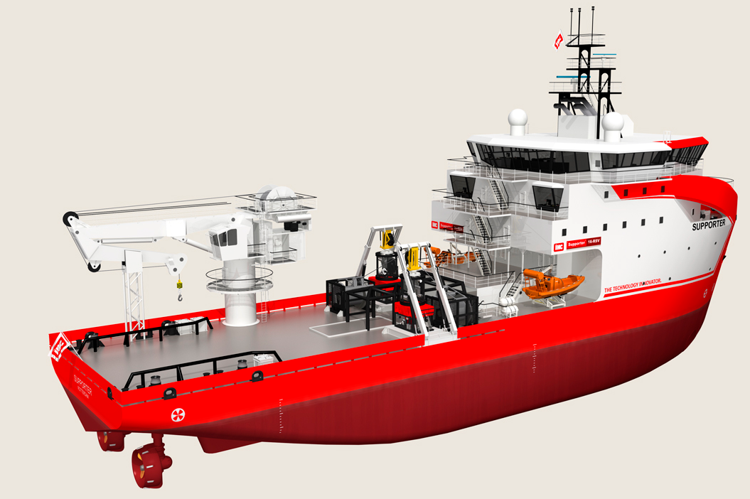
TRAINING VESSEL WITH PROVISION FOR ROV ATTACHMENT
www.royalihc.com/-/media/royalihc/image-carousel/products

Slide 41
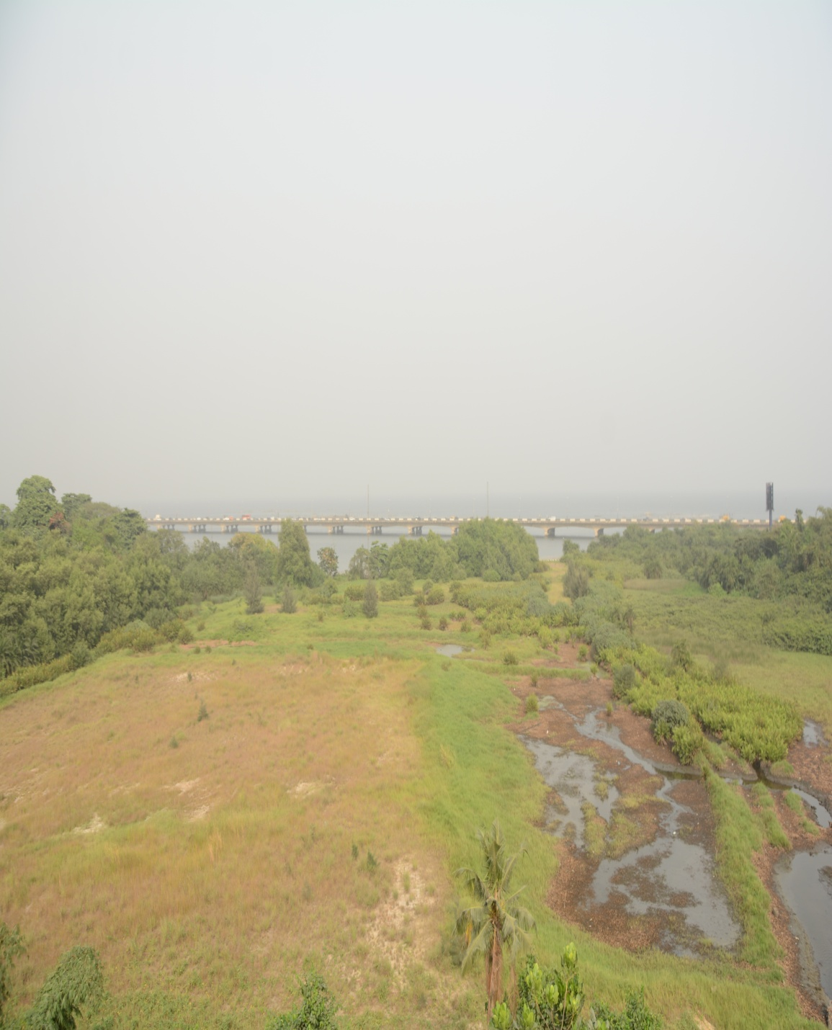
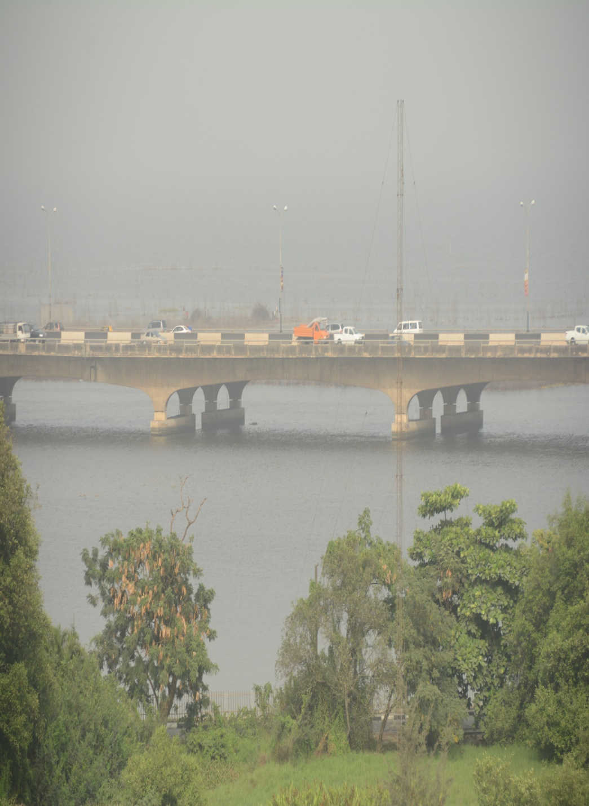
***PLEA TO COMPLETE SAND FILLING (ACCESS ROAD) AND COMMENCE ERECTION OF PERMANENT STRUCTURES

Slide 42
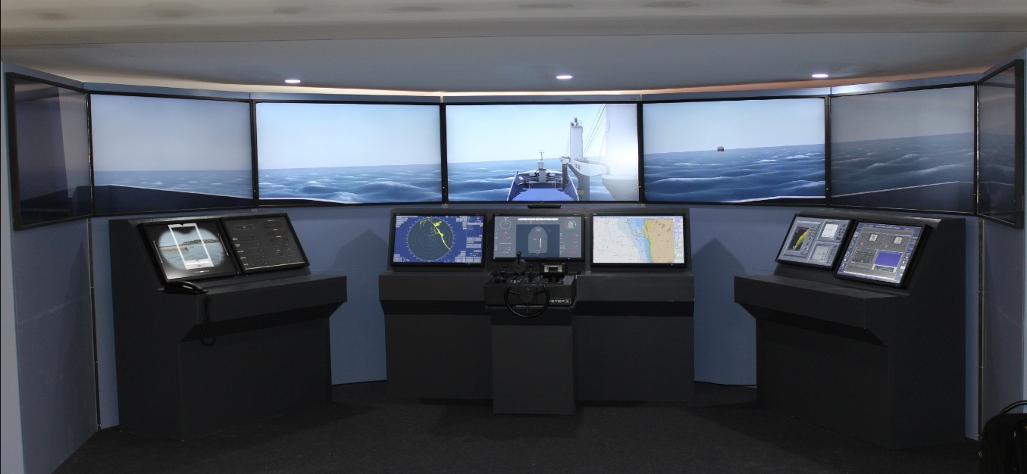
CLASS A FULL MISSION BRIDGE SIMULATOR
A NAUTIS Full Mission Bridge Simulator, as delivered to the Maritime Academy of Nigeria in Oron, is needed for qualitative training.
It includes a GMDSS and Radio Communication’s simulator and has installed with a 180° external field of view and NAUTIS Instructor station.
http://vstepsimulation.com/news/nautis-dnv-class-a-full-mission-bridge-simulator-

Slide 44
BIBLIOGRAPHY
http://www.hellenicshippingnews.com/nigeria-the-many-challenges-of-the-maritime-sector/
www.royalihc.com/-/media/royalihc/image-carousel/products
http://sifaxgroup.com/#2
http://www.fivestarlogisticsltd.com/homepage%20header%205star%20website.jpg
https://pbs.twimg.com/media/DAV05b1XYAA3pHJ.jpg
http://www.portstrategy.com/__data/assets/image/0028/187714/Apapa-Lagos-Nigeria-APMT.jpg
https://guardian.ng/wp-content/uploads/2017/05/Apapa-28-05-17.jpg
http://cimsec.org/wp-content/uploads/2014/06/Maritime-Zones.jpg-2.jpg
http://1.bp.blogspot.com/-VUFD3yYrZBQ/ViuNq_vyK2I/AAAAAAAADek/AQTKdVfb1Y8/s1600/2015-10-24_0953.png

